Slide 2
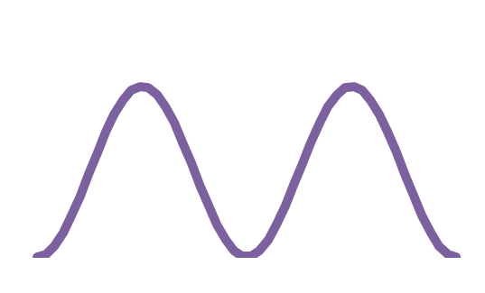
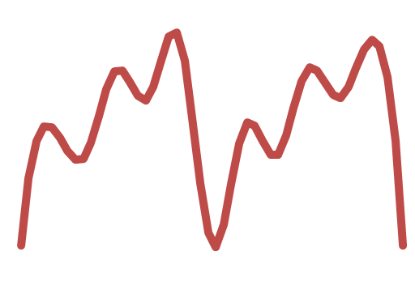
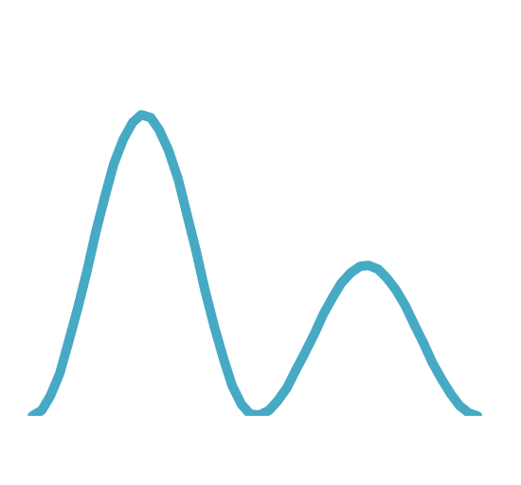
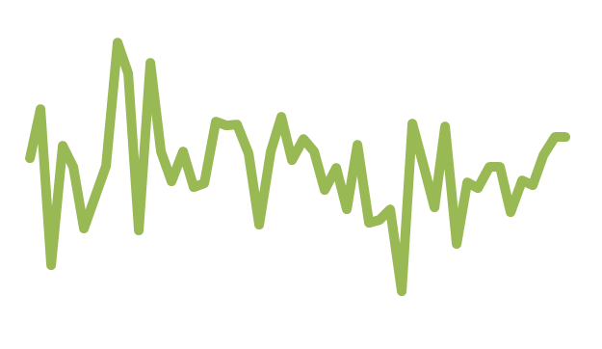
What is recurrence, and how do we quantify it?
Notes:
intuitively : existence of a distinctive pattern. Then decide what you can let slide : change in length of period, dampening, high noise
periodicity geometrically : should be a circle in some parameter space. geometric properties of this circle are scores of periodicity
persistent homology is more than topological, it is metric.

Slide 3
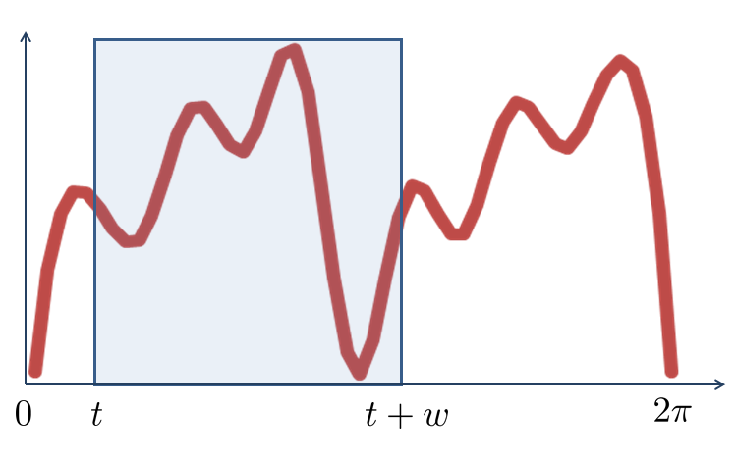
Sliding Windows

Slide 4
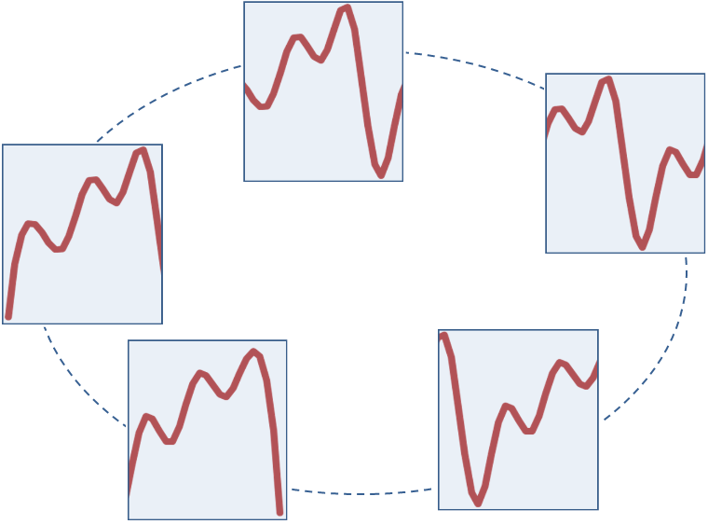
Sliding Windows

Slide 5
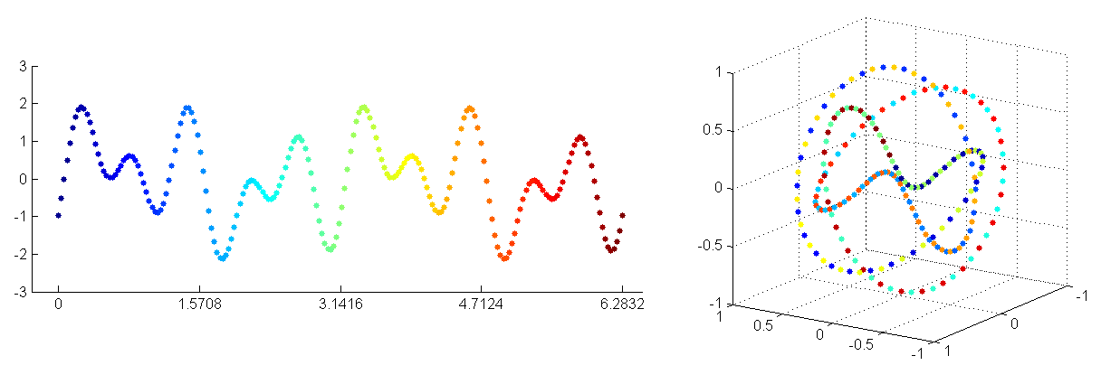
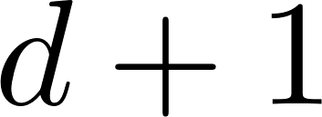

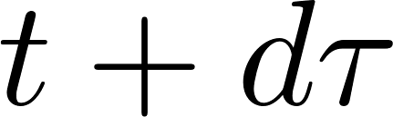
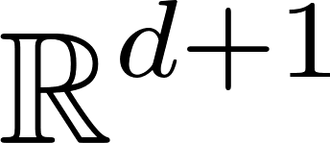
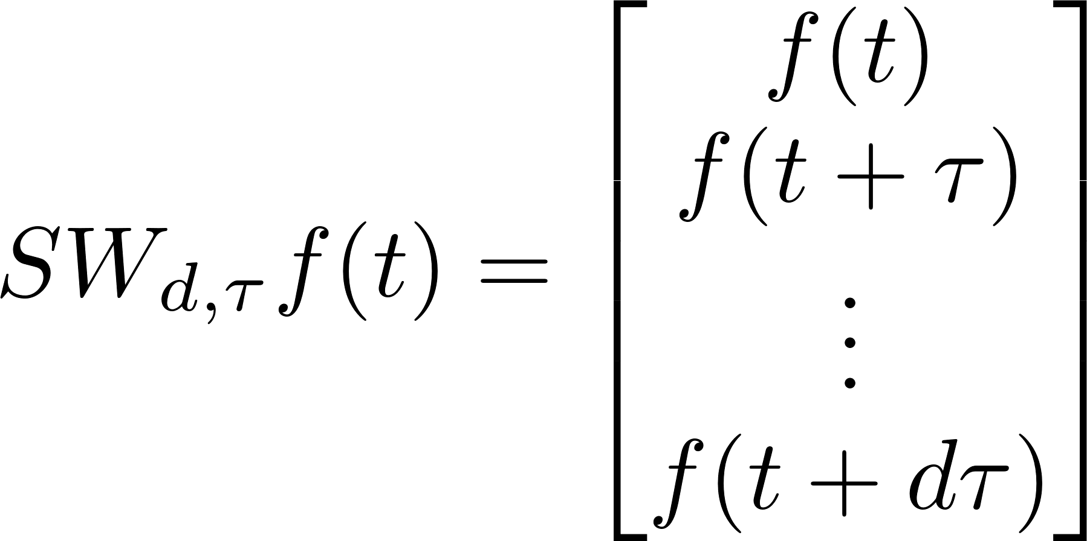
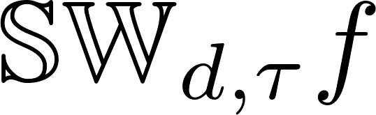

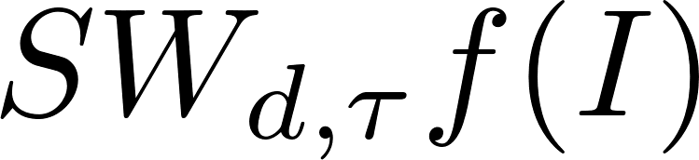

Sliding window embedding
window
Step/delay
Dimension
Sliding window point-cloud
Sliding Windows and Persistence: An application of topology to signal analysis, J. Perea and J. Harer, FoCM 2015
Notes:
in this search we came to sliding window embedding . Rich in geometric structure. So what is the pipeline

Slide 6
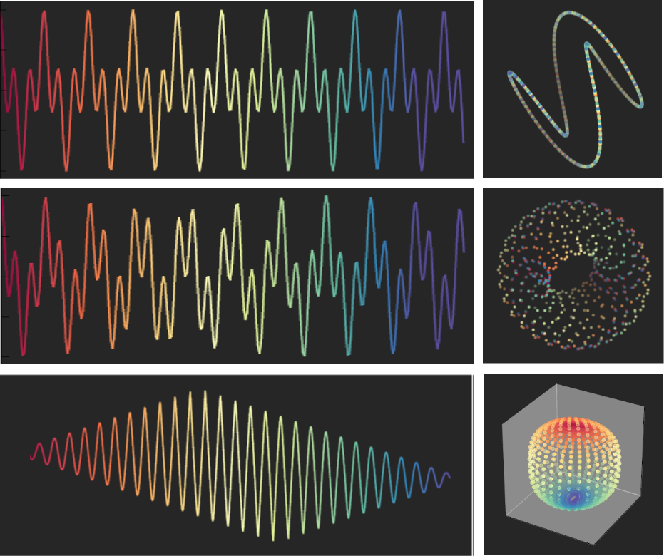
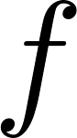

Slide 7
SW1PerS: Sliding Windows and 1-Persistence Scoring

Slide 8
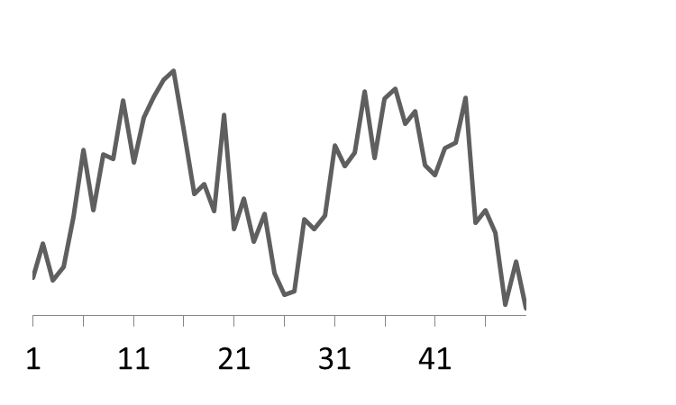


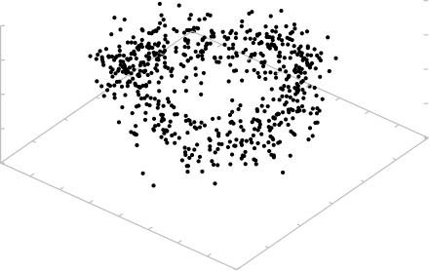
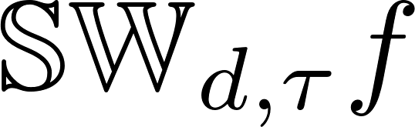
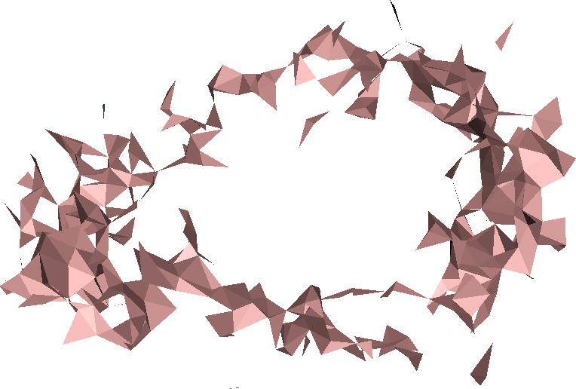
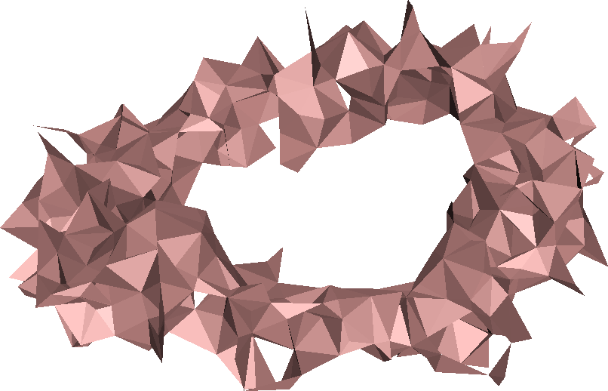
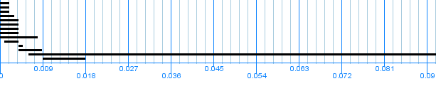
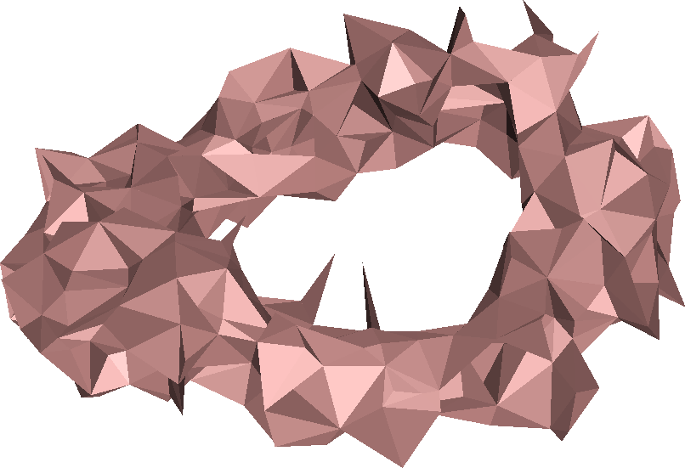
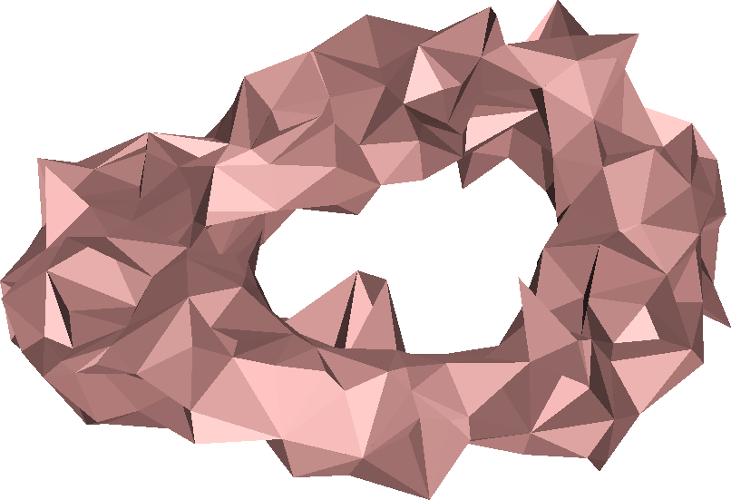
1D- Persistence Barcode
Recurrence score
Sliding Windows and Persistence: An application of topology to signal analysis, J. Perea and J. Harer, FoCM 2015
Notes:
So this is the pipeline we will use. There are some parameters we have to choose

Slide 10
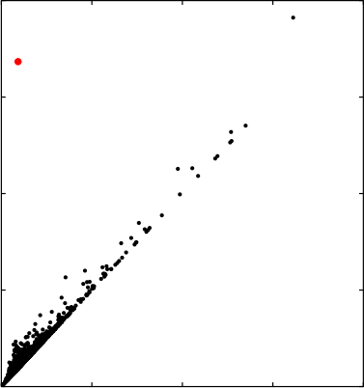

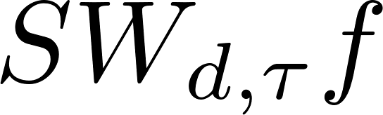
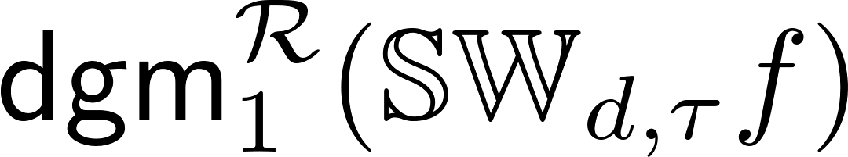

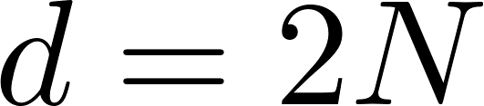

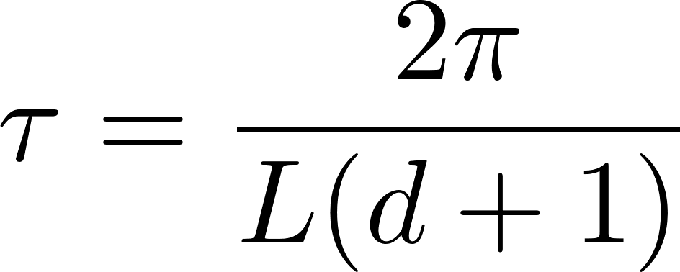
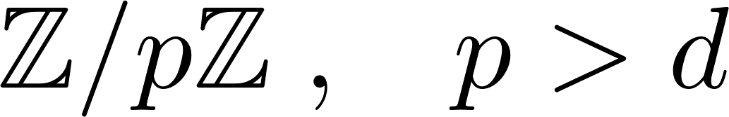
Recap: SW1PerS (Sliding Windows and 1-Persistence Scoring)
mp
# of sines/cosines
number of periods
mp : maximum persistence
(recurrence score)
Shape agnostic
Resistant to dampening
Field of coefficients

Slide 11
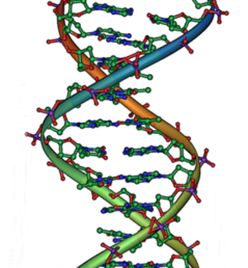
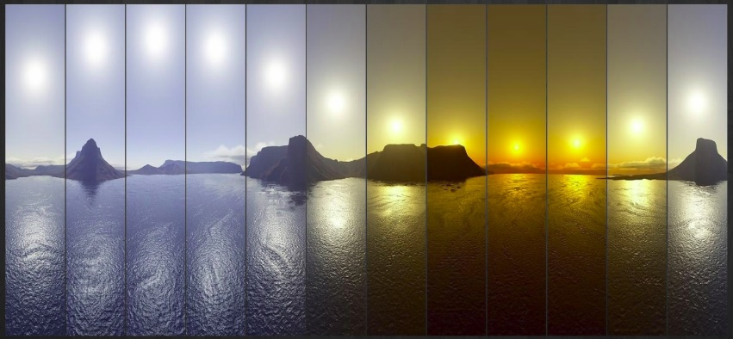
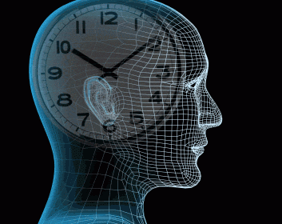
Biological Clocks

Slide 13
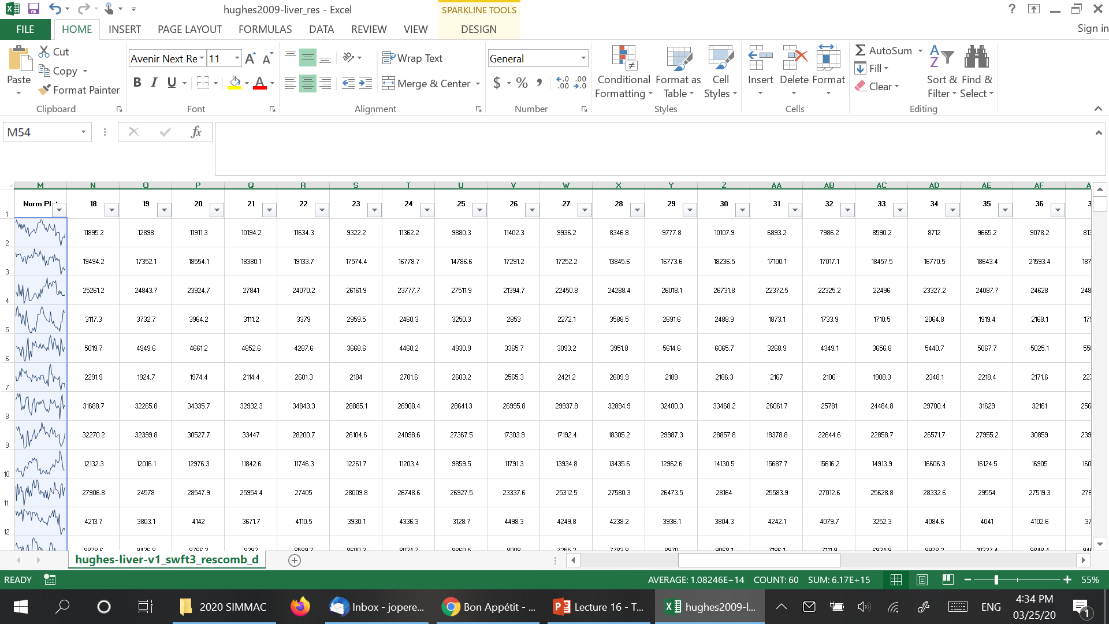
SW1PerS: Sliding Windows and 1-Persistence Scoring, J. Perea et. al., BMC BioInformatics 2015

Slide 14
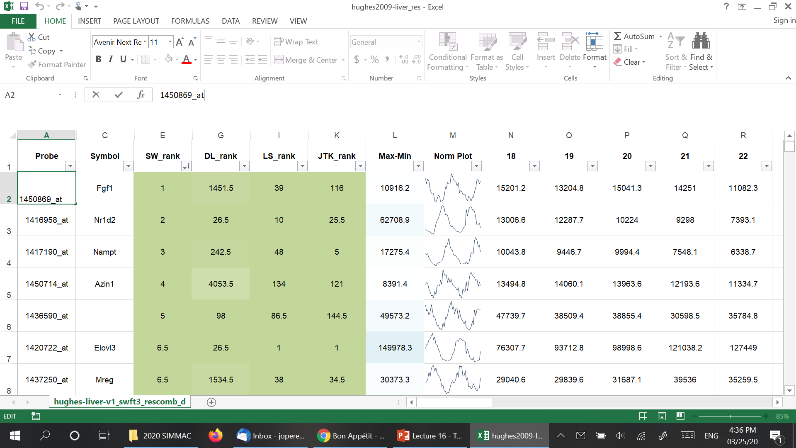
SW1PerS: Sliding Windows and 1-Persistence Scoring, J. Perea et. al., BMC BioInformatics 2015

Slide 15
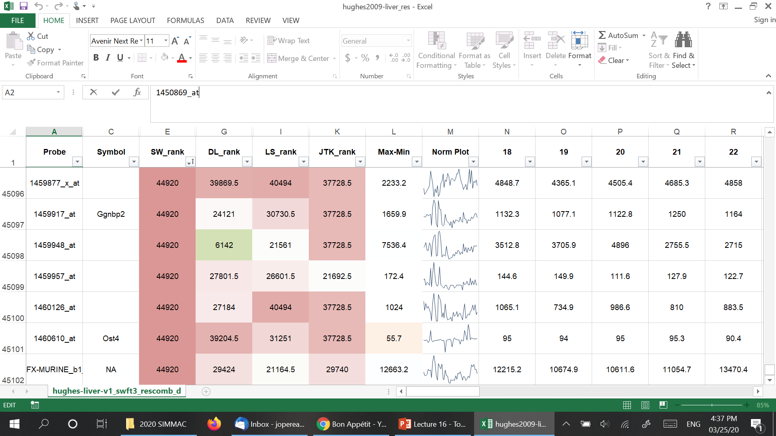
SW1PerS: Sliding Windows and 1-Persistence Scoring, J. Perea et. al., BMC BioInformatics 2015

Slide 16
Yeast Metabolic Cycle Data
Rankings of genes in the top 10% (out of 9,330 ) according to SW, and not in the top 10% for any other algorithm
SW1PerS: Sliding Windows and 1-Persistence Scoring, J. Perea et. al., BMC BioInformatics 2015

Slide 21
arXiv:2103.04540

Slide 22
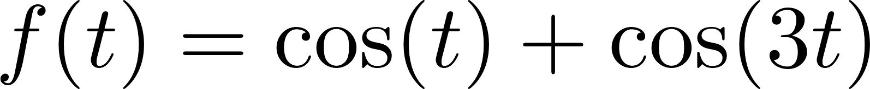
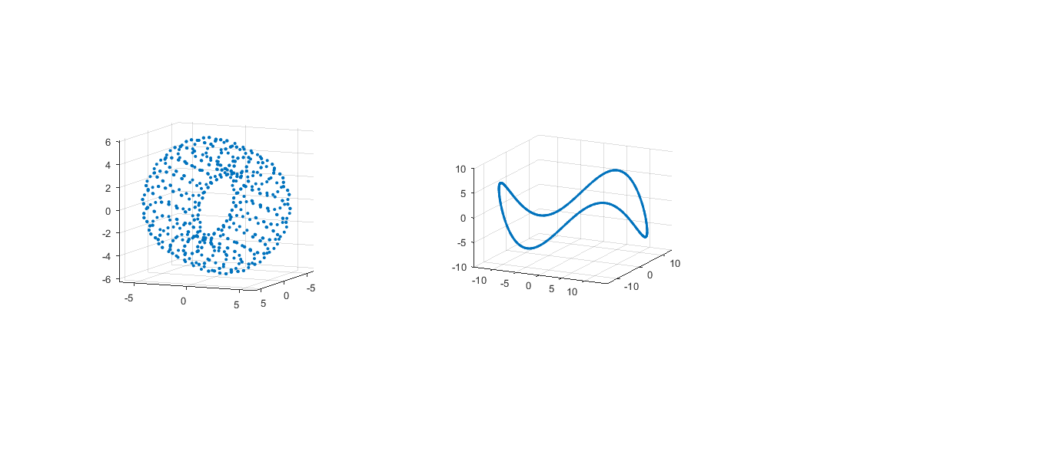
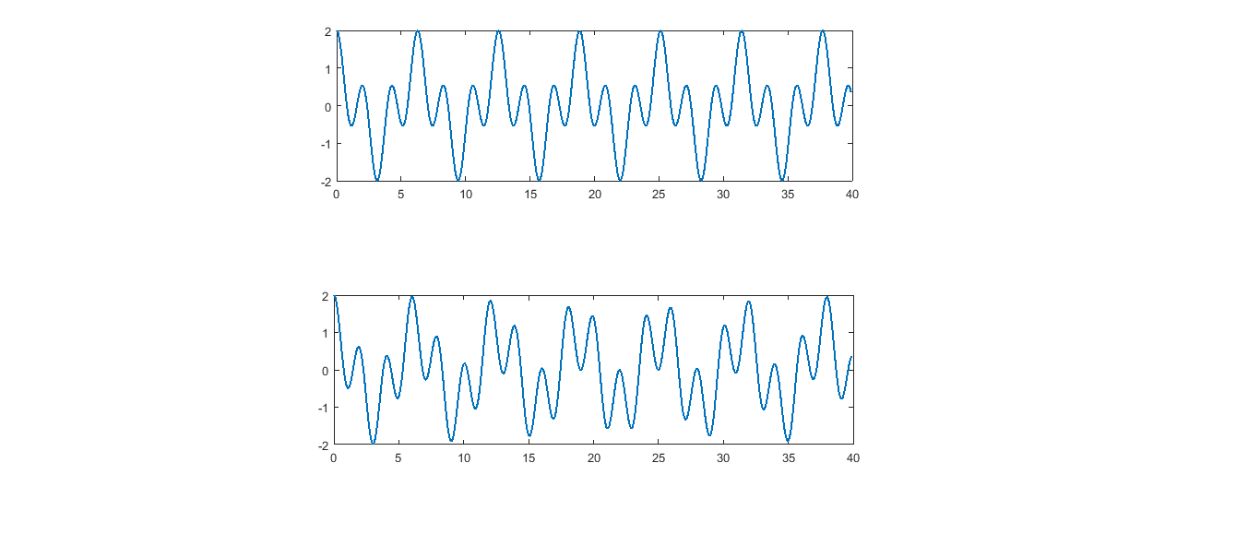
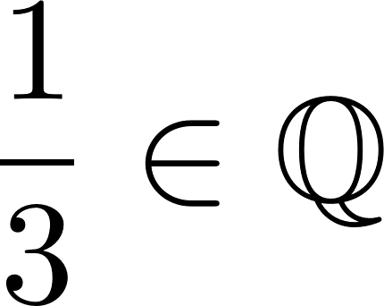
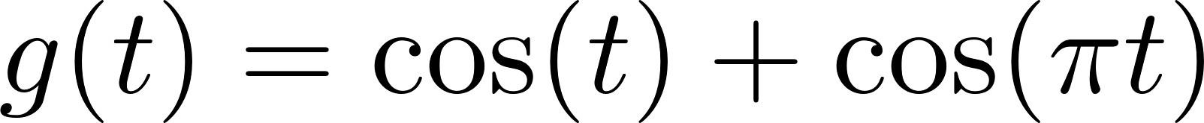
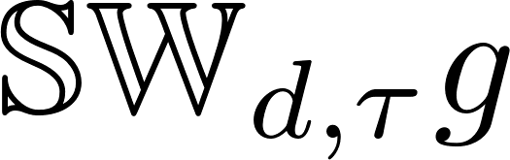
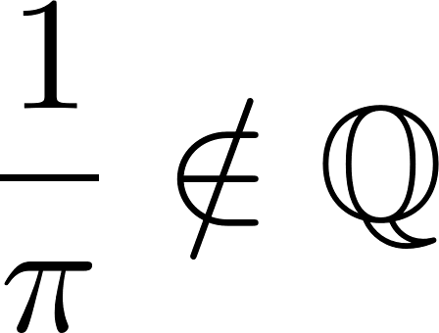
Commensurate
Non- Commensurate
Time Series
Sliding Window Point Cloud
Notes:
Computing persistence is not cheap. If one hopes to develop online-detection of quasiperiodic behavior then need to understand how PH behaves so that one can derive approximations.

Slide 23
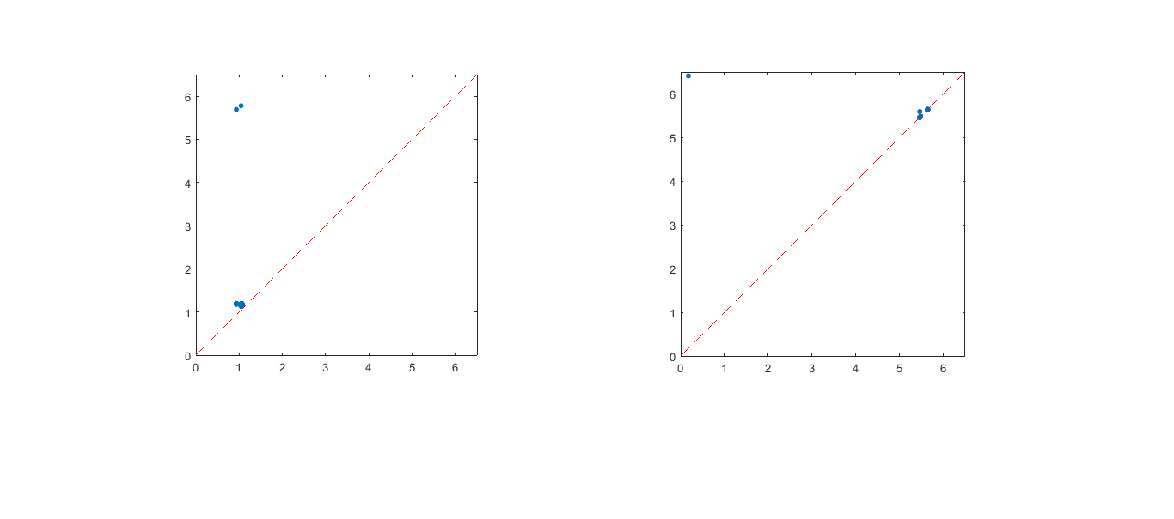


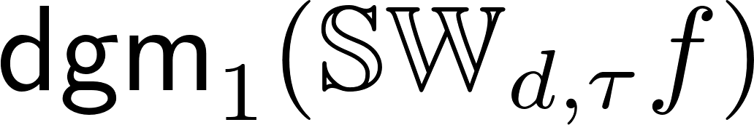


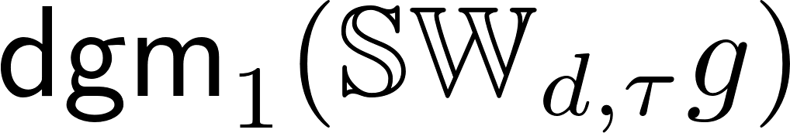
Time Series
Sliding Window Point Cloud
Persistent Homology
Notes:
Computing persistence is not cheap. If one hopes to develop online-detection of quasiperiodic behavior then need to understand how PH behaves so that one can derive approximations.

Slide 24
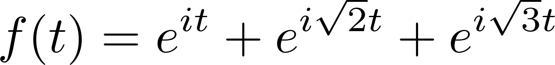
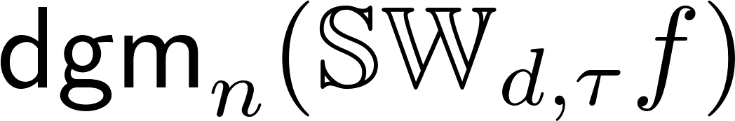
Example:

Slide 30
Notes:
Abnormal whistling sound produced while breathing, associated with obstructed airways and lung deseases

Slide 31
Notes:
Abnormal whistling sound produced while breathing, associated with obstructed airways and lung deseases

Slide 32
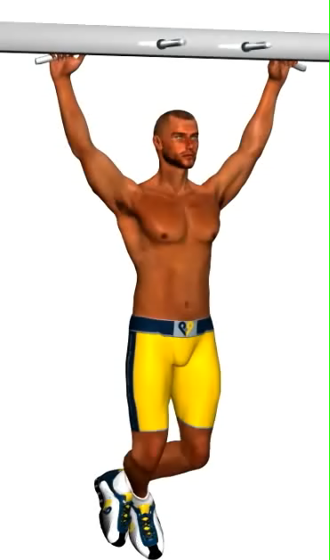
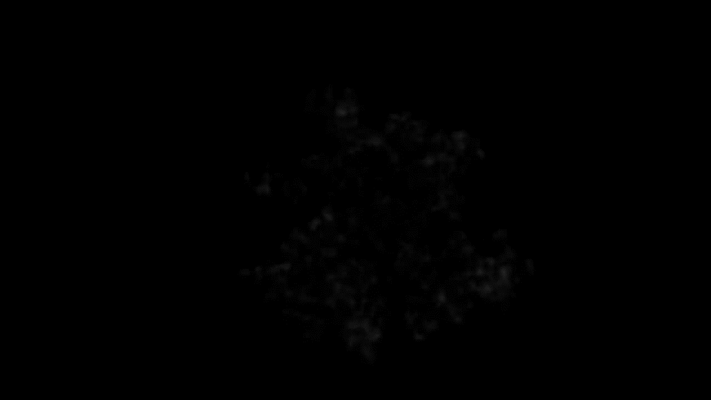

Which Video Is The Most Periodic?
Notes:
We start off asking a deceptively simple question: which one of these videos is the most periodic; that is, which video repeats itself the most perfectly? Our initial goal will be to answer this question algorithmically, but in the process we will stumble into some very deep theory and a host of other applications. But this is our starting point.

Slide 33
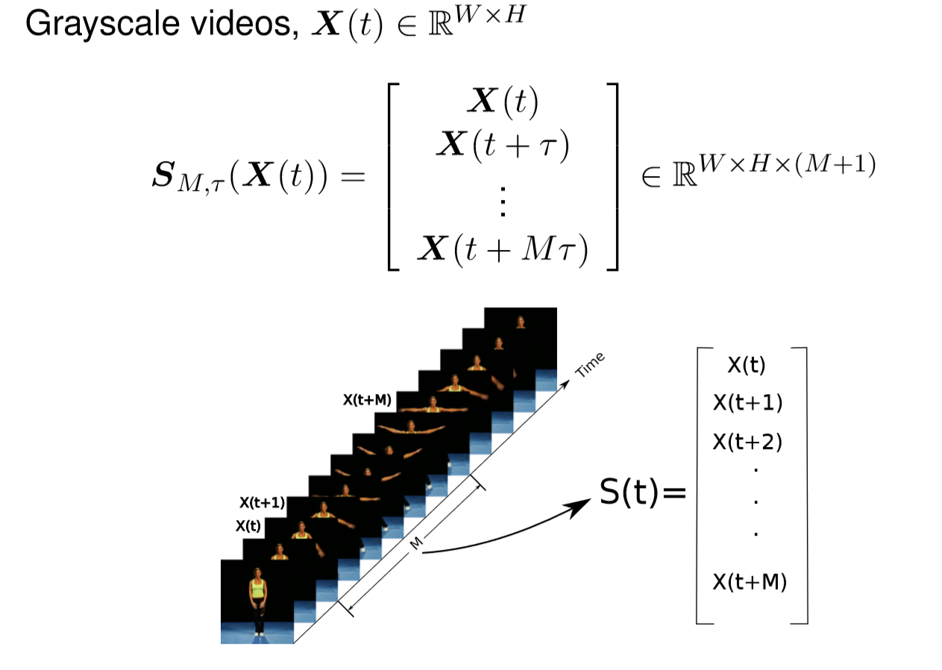
Sliding Window Videos: A Generalization
NOTE: 1D time series are single pixel videos
Notes:
My main contribution has been to create a straightforward “spatiotemporal” generalization of this single variable sliding window to handle a video. A video is a multivariate time series, where a grayscale frame that’s W pixels in width and H pixels in height can be thought of as a point in W*H dimensions. Then, a sliding window video embedding is simply taking such a frame and its lags and concatenating them all into one huge vector in WxHx(M+1) dimensions (NOTE: I have some tricks to deal with the large memory footprint that such a naïve definition would cause, but they are beyond the scope of these slides).
Note that in this framework, 1D time series can be thought of as a single pixel video

Slide 34


Sliding Window Videos: A Generalization
Time series are a single pixel video!
Notes:
Just to really hit the point home, the left shows each window for a sliding window video for a woman doing jumping jacks, and the right plot shows PCA down to 3 dimensions. And below are a couple of references where I define this and talk about some computational tricks

Slide 35

Fourier Series Expansion
Notes:
Let’s think a little bit now about the geometry of this embedding when a video is perfectly periodic. A perfectly periodic video is such that every pixel can be written as a Fourier series. Then we can stack up the Fourier coefficients for each pixel into a vector and write a video as a vector Fourier series. And then we can write a sliding window in that form as well

Slide 36

Fourier Series Expansion
Traces a path on the K-torus!
Notes:
Now we just play a trick from high school trigonometry where we can separate out the cosine of a sum into the product of two cosines minus the product of two sines. When we do this, we end up with a component that only depends on the lag Tau, which is fixed, and a component that depends on t, for both sine and cosine. But what we notice is, for each frequency, this is simply parameterizing an ellipse. So the space curve we end up with simultaneously traverses K different ellipses for K frequencies. In other words, it traces a path on the K-torus. And we need 2K dimensions for K Fourier components to properly represent all of the geometry.

Slide 37

Natural Videos, Periodic Summation
Notes:
So in practice, how many Fourier coefficients do we need for “natural videos”? Let’s look at this pixel I’ve highlighted in green over time. Notice that there are sharp transitions when the pixel switches from background to foreground and back again, which makes it almost look like a square wave. This suggests we may need many harmonics to faithfully represent this pixel.

Slide 38









Natural Videos, Periodic Summation
Notes:
Another experiment we can do is to perform PCA and look at the principal axes we need to explain most of the variance. In this case, each principal axis is itself a video, since it describes a frame and its lags. So we can play it back as a video. What we notice is that PCA recovers the Fourier series coefficients; principal components come in “in phase” and “quadrature” pairs

Slide 39


Disambiguating Mirror Symmetric States
Notes:
One example that illuminates why one might need these time lags for takens is an example of a pendulum swinging by. It has mirror symmetry in the second half of its period, so if we do PCA on just the raw frames, we see that we trace a path going from left to right, and then we retrace the path going from right to left. In other words, if I just give you a single image of the pendulum, you don’t know if it’s swinging left or right, so it’s impossible to disambiguate “going there” from “coming back.” But if I just add one extra frame, I get the time history I need to disambiguate them. Another way to look at this is that the embeddings are allowing us to numerically approximate derivatives.

Slide 40

Disambiguating Mirror Symmetric States
Notes:
One example that illuminates why one might need these time lags for takens is an example of a pendulum swinging by. It has mirror symmetry in the second half of its period, so if we do PCA on just the raw frames, we see that we trace a path going from left to right, and then we retrace the path going from right to left. In other words, if I just give you a single image of the pendulum, you don’t know if it’s swinging left or right, so it’s impossible to disambiguate “going there” from “coming back.” But if I just add one extra frame, I get the time history I need to disambiguate them. Another way to look at this is that the embeddings are allowing us to numerically approximate derivatives.

Slide 41

Ranking Videos by Periodicity
Notes:
Now I’m going to talk about some work I did with Jose Perea to validate this sliding window video approach

Slide 42


Mechanical Turk Human Periodicity Ratings
Notes:
To validate this technique, we drew 20 random creative commons videos from Youtube of varying degrees of repitition. We then ran an experiment where we compared the rankings we got from Sw1perS on sliding window videos to rankings that humans gave to these videos. To get at human rankings, we presented pairs of videos to humans on the Amazon mechanical turk and asked them which video “repeated itself more perfectly.” We then used Hodge rank aggregation to compute a global ranking from these data.

Slide 43

Mechanical Turk Human Periodicity Ratings
Show example videos
Notes:
When comparing the rankings we get from Sw1PerS with the human rankings, we have a higher agreement than with more traditional Fourier or autocorrelation techniques.

Slide 44

Autism Stereotypical Motor Motions
Notes:
Now I’m going to talk briefly about a real application of this work to autism spectrum disorder, which was joint work with Matthew Goodwin at Northeastern and Guillermo Saprio at Duke

Slide 45


Autism Stereotypical Motor Motions
4 Types of Motions: Rock, Flap, Flap-Rock, Nonperiodic
Data: 3 3-axis accelerometers on two wrists and trunk^{[1]}
(think of as 3-pixel videos)
Notes:
Children on the autism spectrum tend to exhibit these periodic “stereotypical motor motions” (body rocking, hand flapping) during high valence emotional states (e.g. excitement, agitation), and this is ubiquitous across cultures. We analyze data from 3-axis accelerometers placed on the childrens’ wrists and abdomen. In the context of sliding window videos, we can think of these as 3-pixel videos.

Slide 46

Autism Stereotypical Motor Motions
Rock action
Notes:
Sw1PerS gives us an interpretable score during a rocking motion; the trunk (torso) has a higher periodicity score during rocking, while the wrists mostly remain low

Slide 47

Autism Stereotypical Motor Motions
Flap-Rock action
Notes:
During a “flap-rock” action, both wrists and the trunk have high periodicity scores.

Slide 48


Autism Stereotypical Motor Motions
KNN 4-class cross-validation results
RQA + TDA > RQA, TDA
Notes:
When we supervised learning using the 3 Sw1Pers features from the two wrists and torso, we do almost as well as 27 more traditional recurrence quantification features, and they are much more interpretable. Furthermore, when we combine these features with RQA features, we get an improvement in performance over either alone. So our features are adding complementary information

Slide 49
Vocal Fold Pathology Identification in Video
Notes:
Now I’m going to switch back to another application I was working on with Jose Perea looking at vocal fold pathologies from high speed videos of vocal folds

Slide 50


High Speed Glottography
Notes:
Now we’re ready to jump into the application. We will be looking at high speed (4000 frames per second) videos of the glottis down the throat while someone goes “aaaah”

Slide 51

Vocal Fold Videos
Notes:
For normal, healthy patients, we see oscillatory behavior and a nice, clean loop in PCA

Slide 52

Vocal Folds Videos
Healthy Periodic
Notes:
Indeed, the persistence diagram reflects one clear loop

Slide 53


Vocal Fold Videos
Biphonation (Quasiperiodicity)
Notes:
However, if a very subtle change happens with partial paralysis in the vocal folds, we see in PCA we’re getting something that isn’t a perfect loop, and which even looks a bit like a torus from PCA.

Slide 54

Vocal Fold Videos
Biphonation (Quasiperiodicity)
Notes:
Indeed, we see a beautiful torus signature in TDA. Even though homology is fancy compared to a lot of engineering tools, this pipeline is actually much simpler and more robust than more traditional computer vision approaches to this problem which try to track the vocal folds, since tracking fails as soon as the edges go away when the vocal folds close. So we were pretty excited about this result. We also believe this is one of the first (if not the first) uses of persistent H2 in high dimensions

Slide 55

Vocal Fold Videos
Irregular
Notes:
Note that when presented with a video of chaotic motion of the vocal folds, we might be tricked into thinking it’s also a torus by looking at PCA

Slide 56

Vocal Fold Videos
Irregular
Notes:
But when we compute the persistence diagrams, we don’t see much of anything. So again, high dimensional tools for high dimensional inference…

Slide 57

Vocal Fold Videos
Subharmonic Biphonation
Notes:
Now let’s look at another video which looks perfectly periodic, but where there’s something very subtle going on.

Slide 58

Vocal Fold Videos
Subharmonic Biphonation
Notes:
When we look at these persistence diagrams, we actually see a different answer when we switch the field of coefficients from Z/2 to Z/3. In fact, there are two dots (b1, d1) and (b2, d2) in the Z/2 diagram which merge together to form a dot (b1, d2) in the second diagram.

Slide 59

Vocal Fold Videos
Mucus Biphonation
Notes:
A similar thing happens for this video here, which has a clear “1 on 2” pattern (mucos flares up every other oscillation). This is referred to as “biphonation”

Slide 60

Vocal Fold Videos
Mucus Biphonation
Notes:
And we see the same kind of splitting when switching the field of coefficients

